Slide 1

ND Broadband Grant Program
WebGrants Software Introduction
Connecting North Dakota Communities
June 7, 2022
Play audio for
each slide here

Slide 2
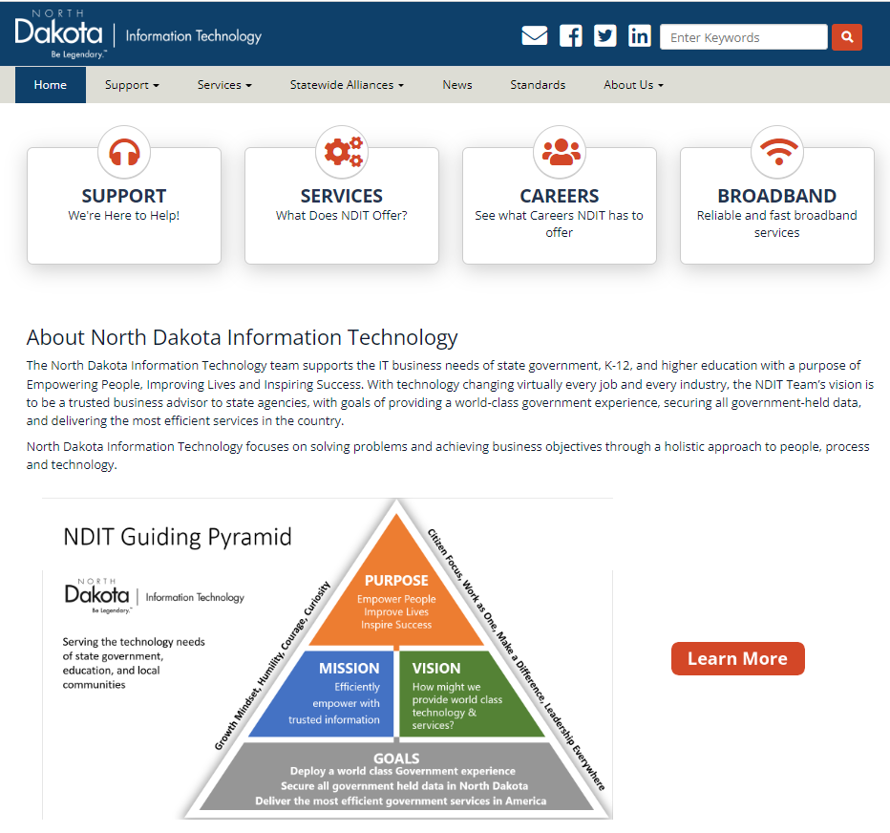
NDIT Home Page
Proceed to Broadband Page
www.ndit.nd.gov

Slide 3

NDIT Broadband Page
Various Grant Home Pages
Broadband Survey
Test your broadband speed
Provides Access to All Broadband Grant Programs

Slide 4
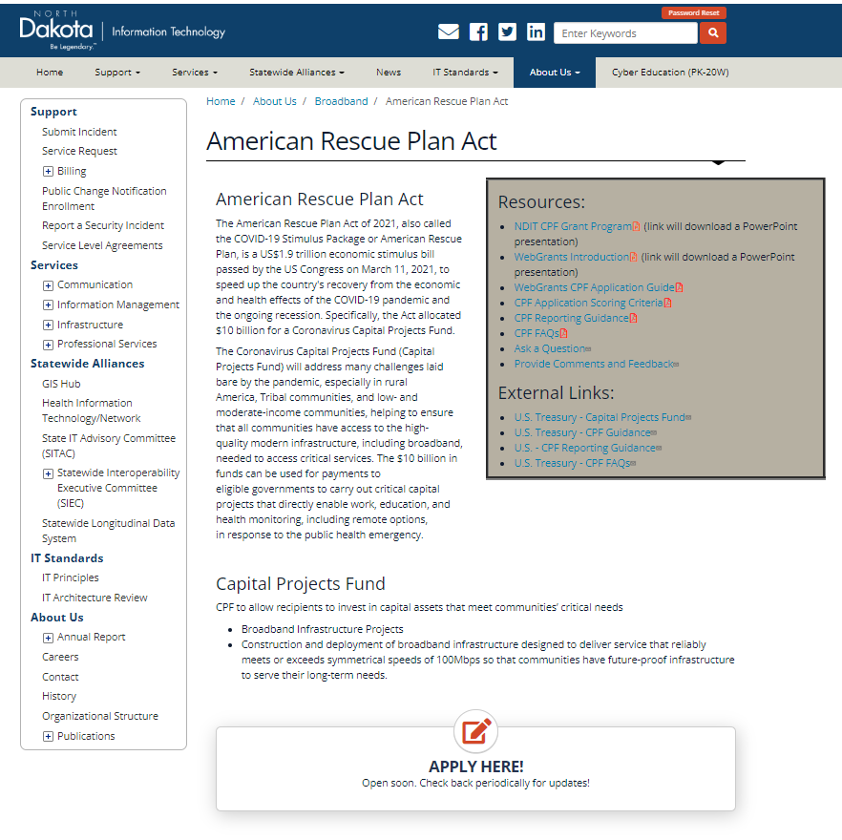
NDIT ARPA CPF Grant Page
CPF Resources
Click to be redirected to the WebGrants software
Access to CPF Application

Slide 5
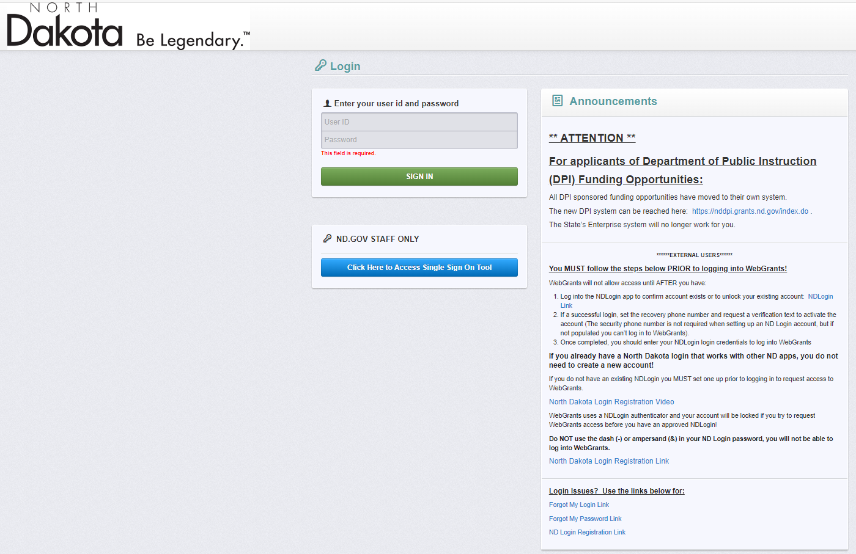
WebGrants Landing Page
Use existing NDLogin
Register for new account
Registration Information

Slide 6
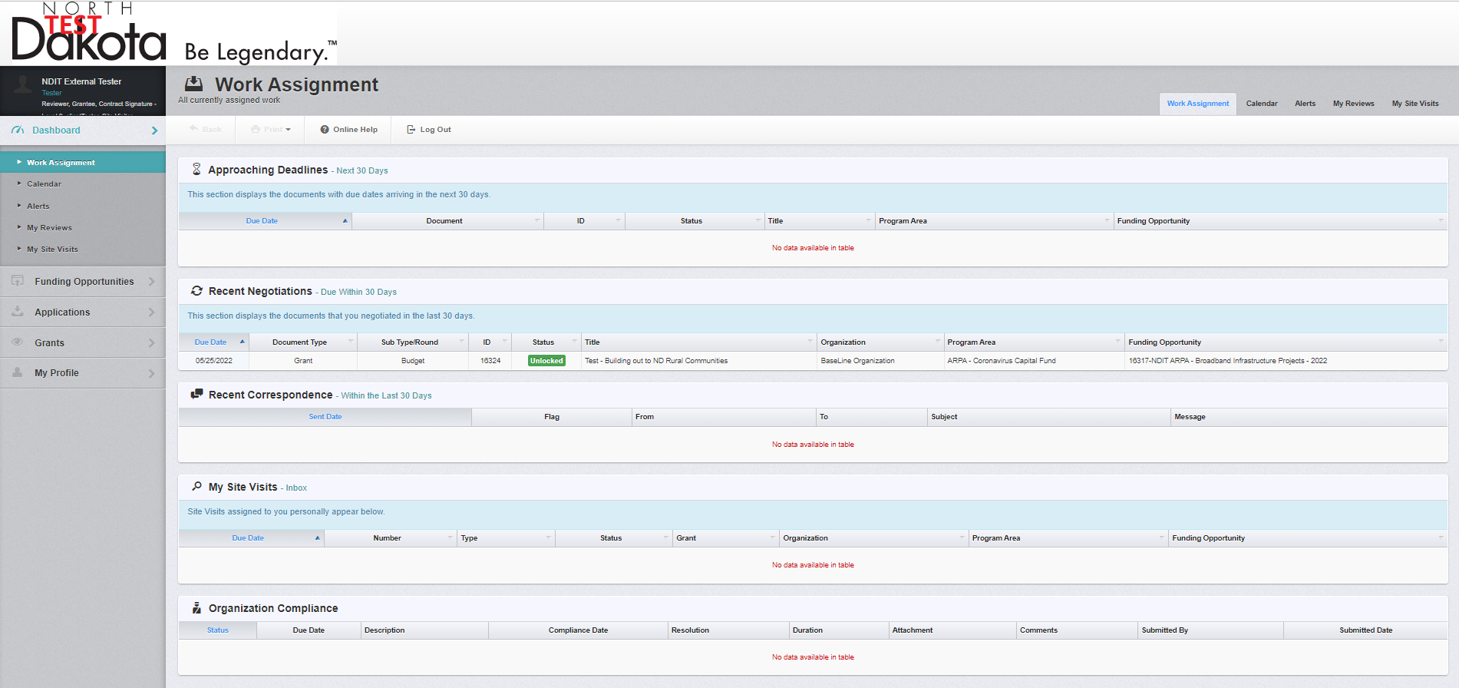
WebGrants Home Page
Dashboard

Slide 7
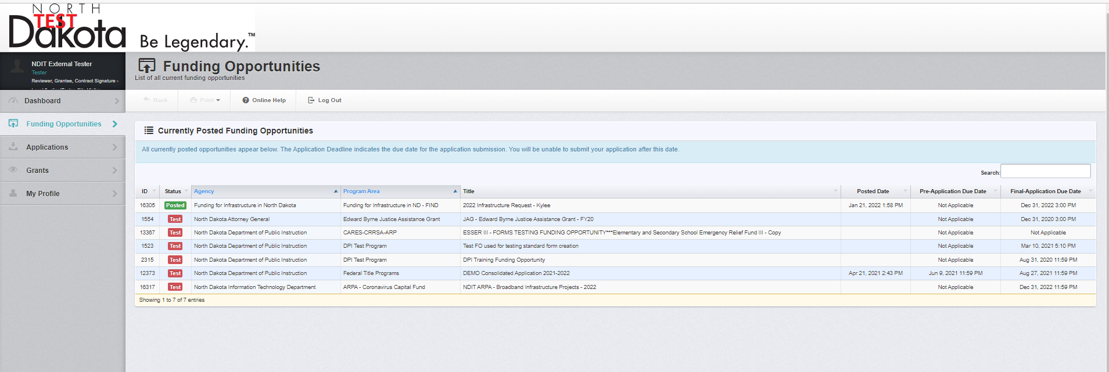
Funding Opportunities Home Page
Search and Select a Funding Opportunities

Slide 8
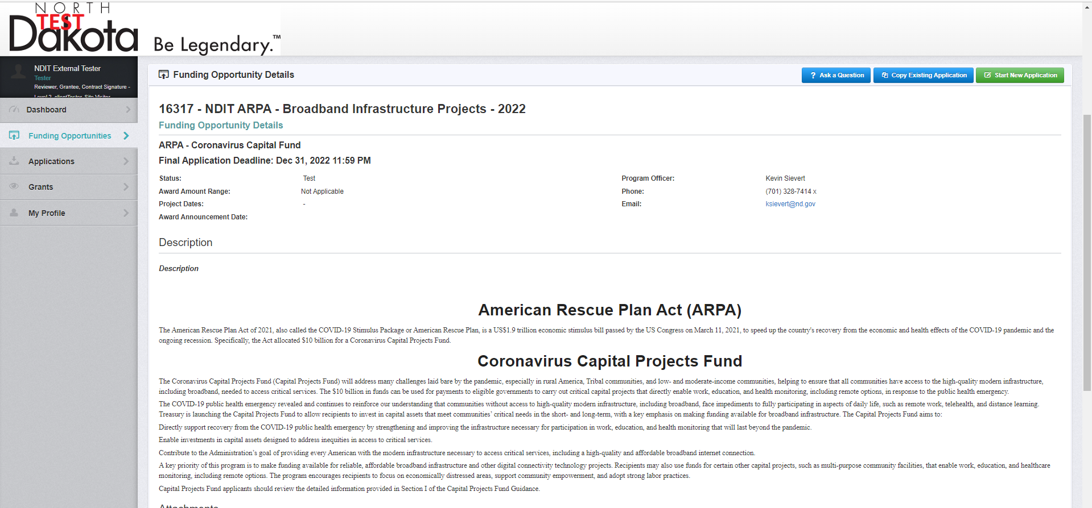
Specific Funding Opportunity Home Page
Start a new application

Slide 9
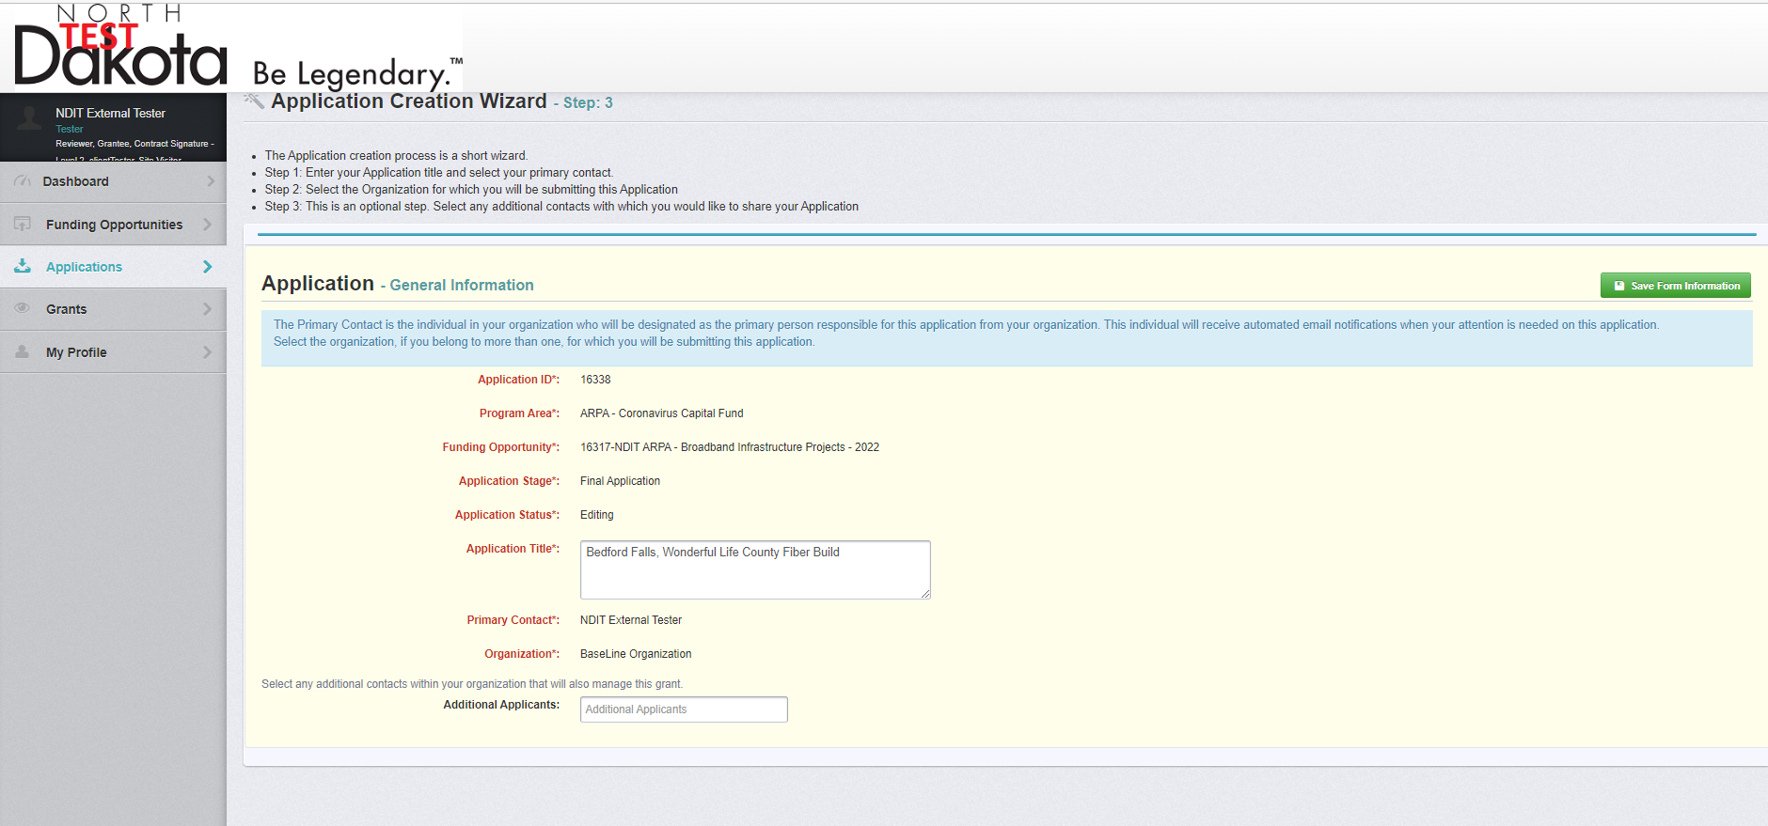
Application
New Application - General Information Section

Slide 10
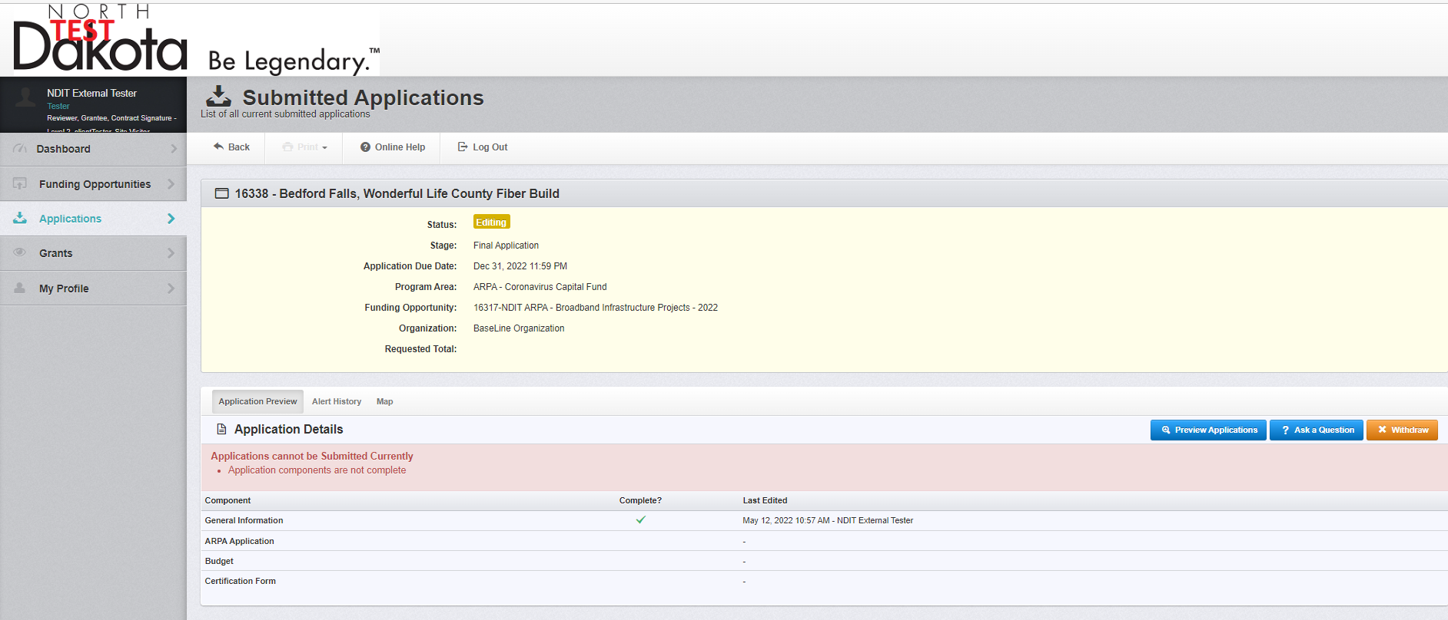
Applications Home Page
Note: You cannot submit
the application until all
sections are completed.
Application – General Information Section Complete

Slide 11
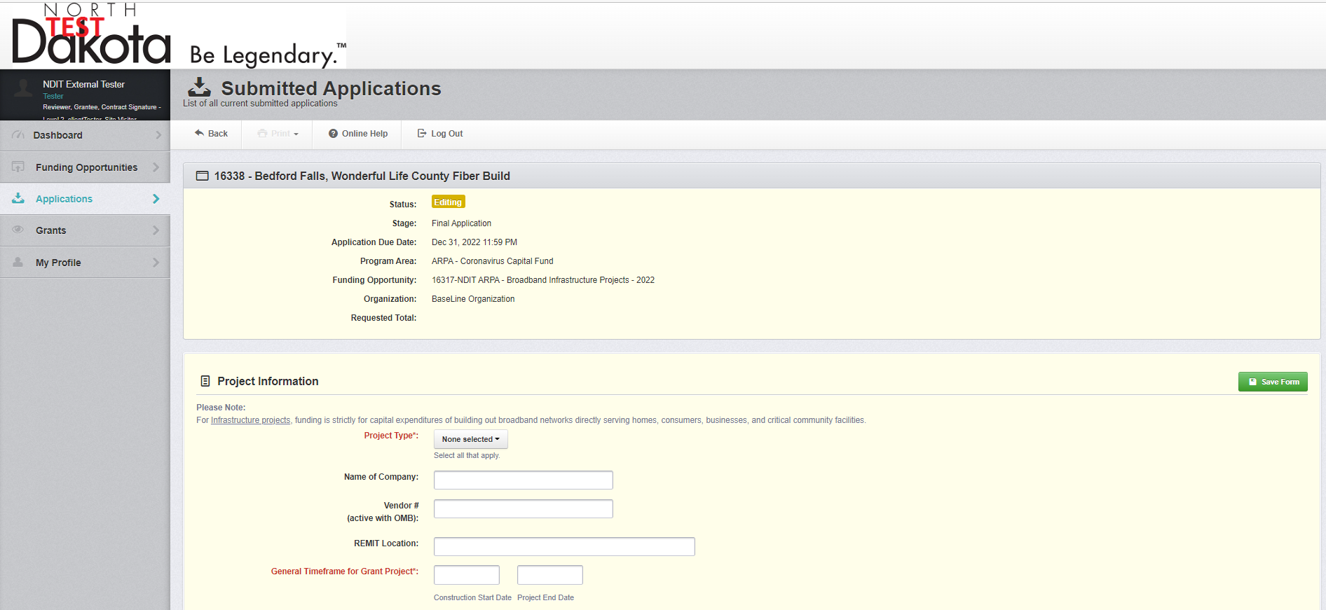

Application
Note a Construction End date will be added to the system.
Project Information Section (1 of 5)

Slide 12
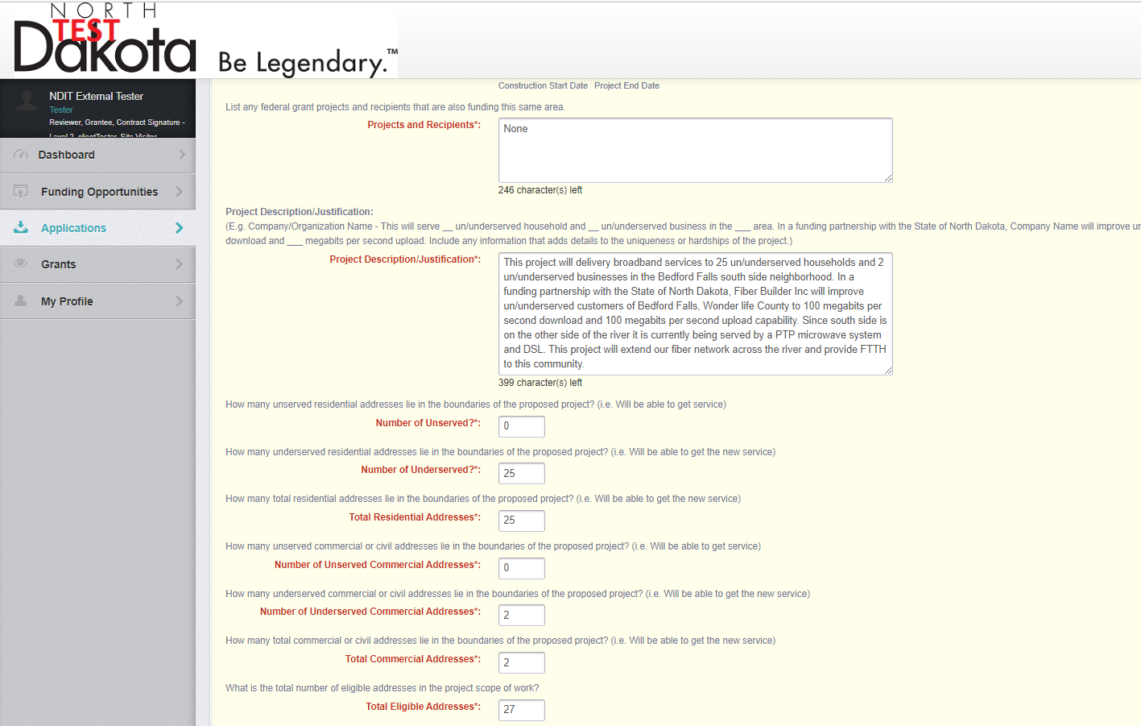
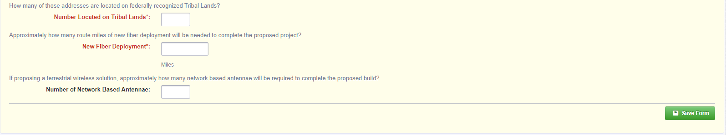
Application
Project Application Section (2 of 5)

Slide 13
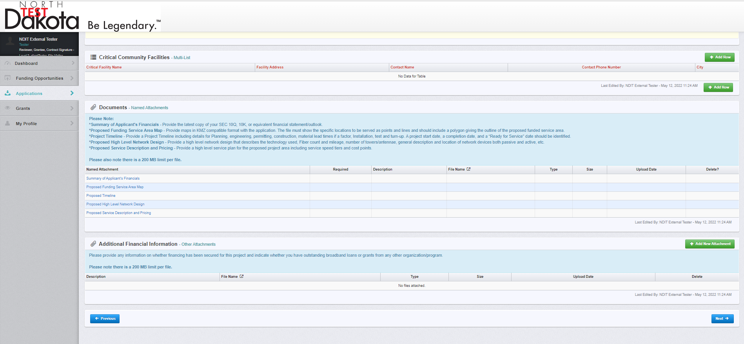
Application
Identifying Critical Community Facilities (3 of 5)

Slide 14
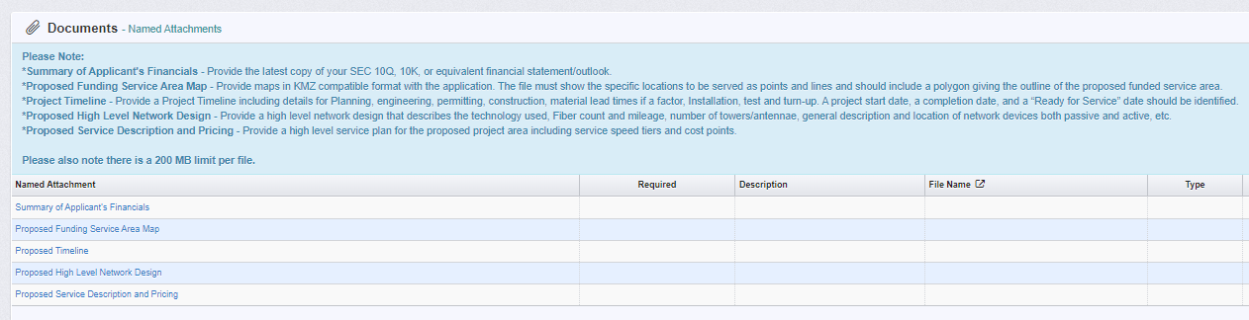
Application
Adding Documents (4 of 5)

Slide 15
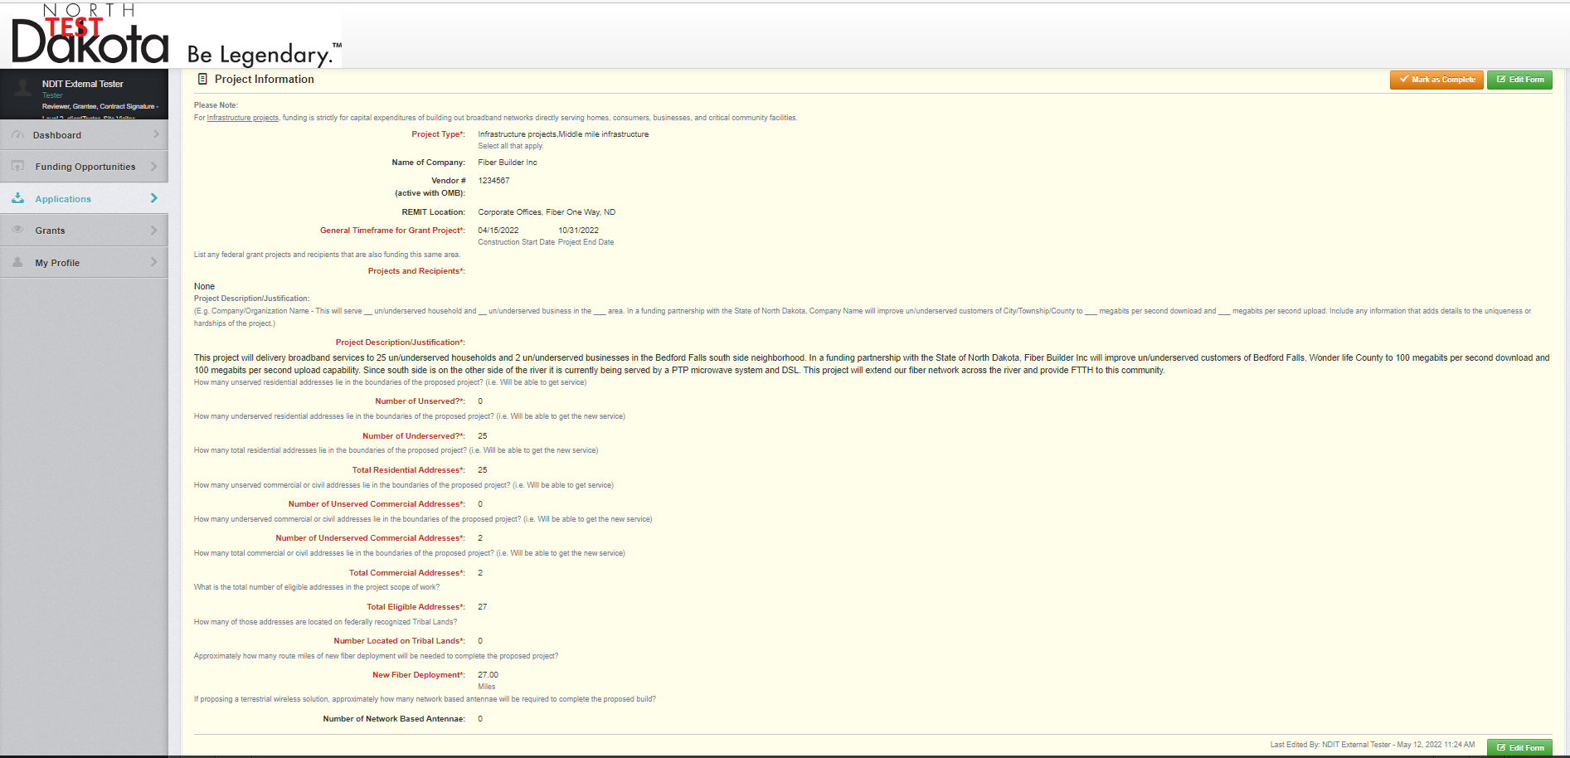
WebGrants Home Page
Completing the Application (5 of 5)

Slide 16
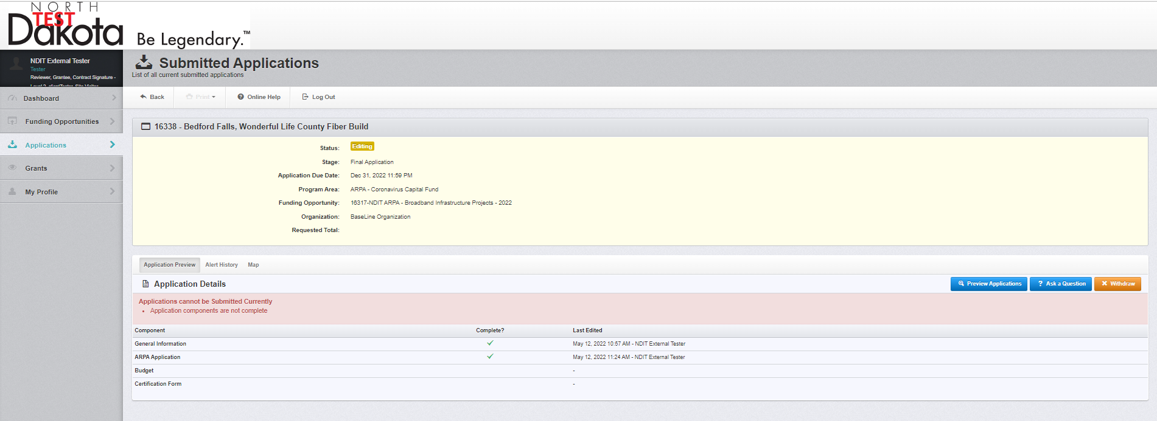
Application Home Page
Application – ARPA Application Section Complete

Slide 17
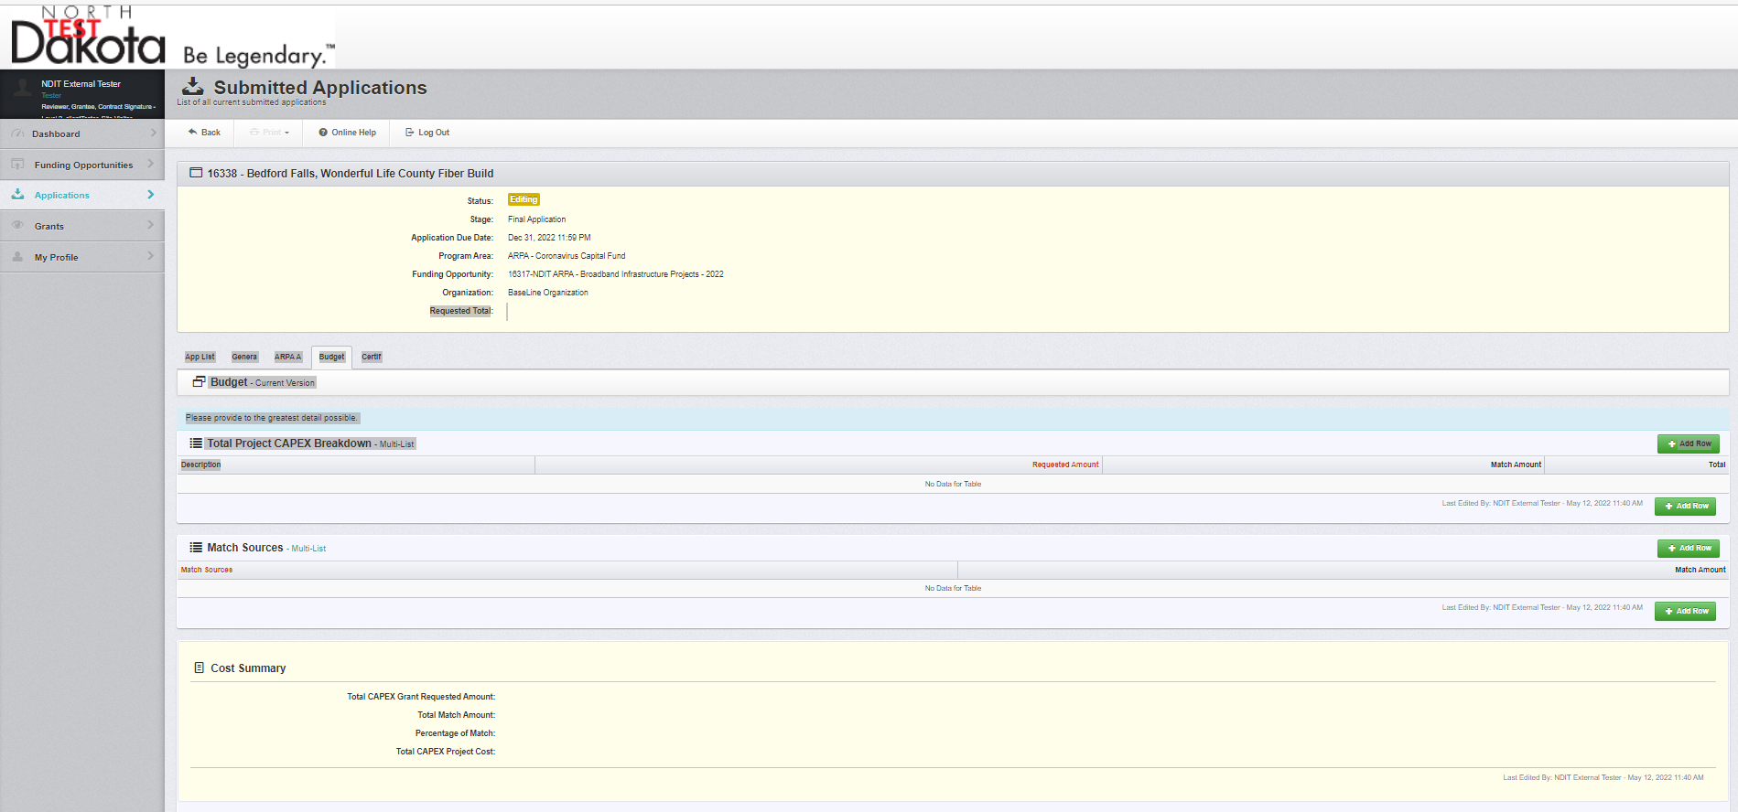
Budget
Adding Budget Line items (1 of 3)

Slide 18
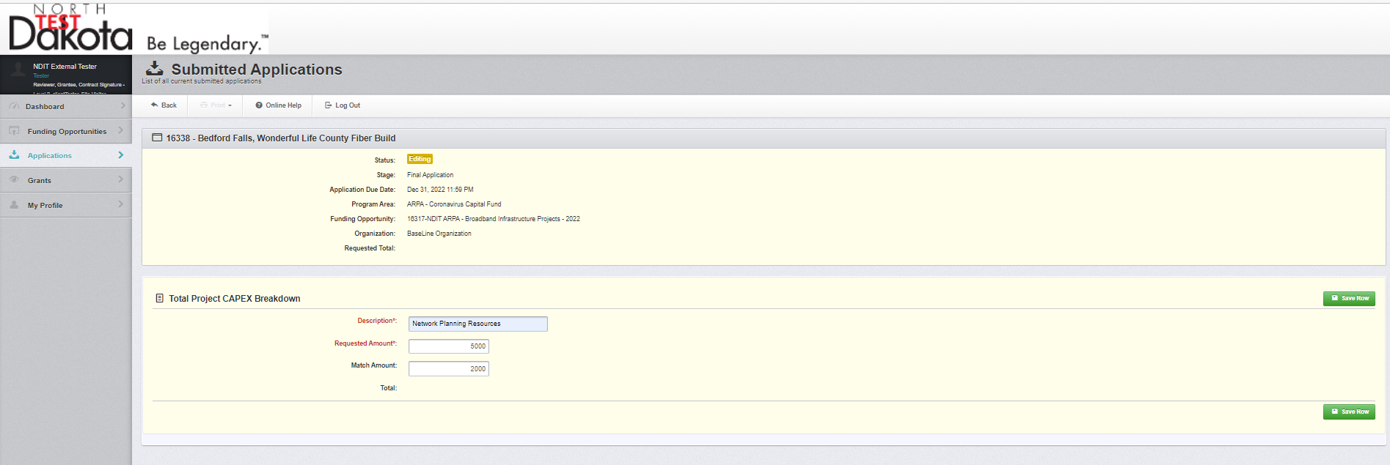
Budget
Adding Budget Line Items (2 of 3)

Slide 19
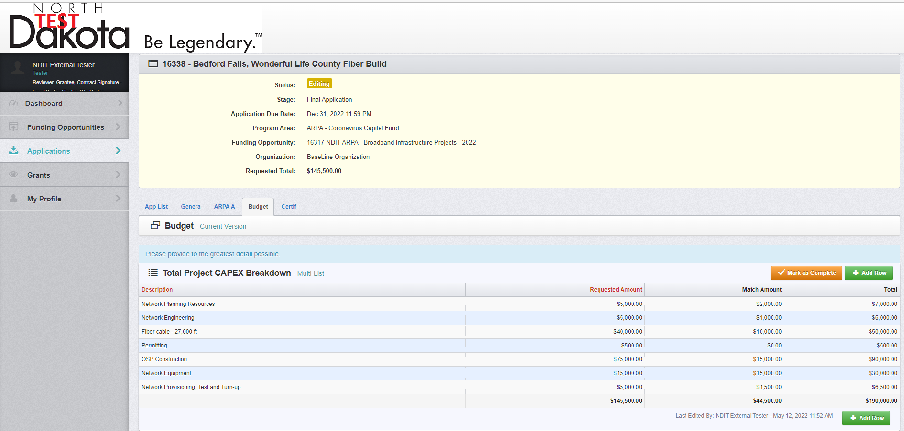
Application
Budget Section Complete (1 of 2)

Slide 20
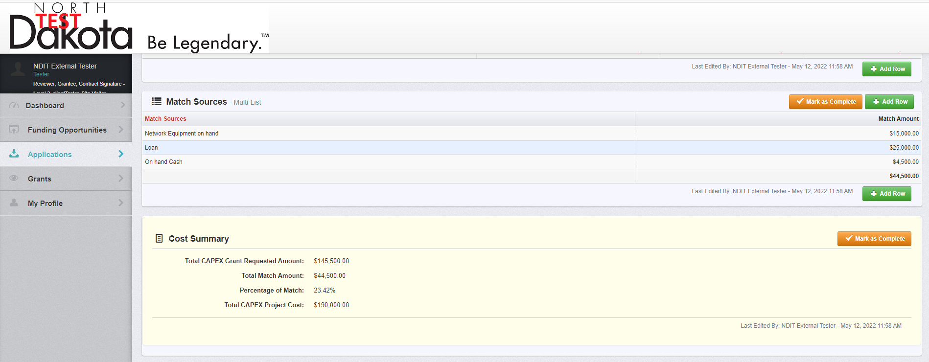
Application
Budget Section Complete (2 of 2)

Slide 21
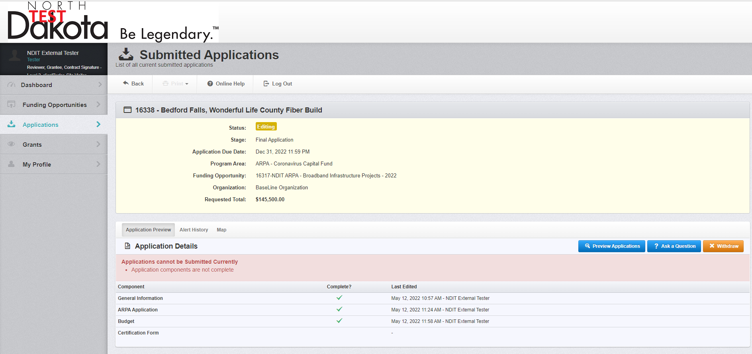
Application Home Page
Budget Section Complete

Slide 22
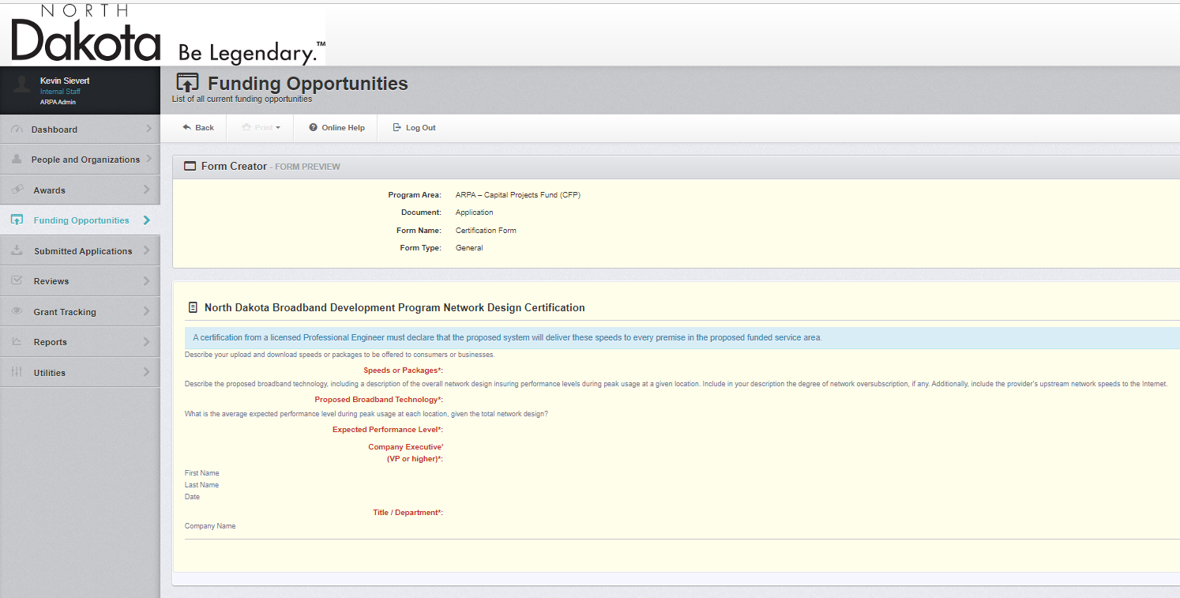
Certification Form
Network Design Certification - Editing

Slide 23
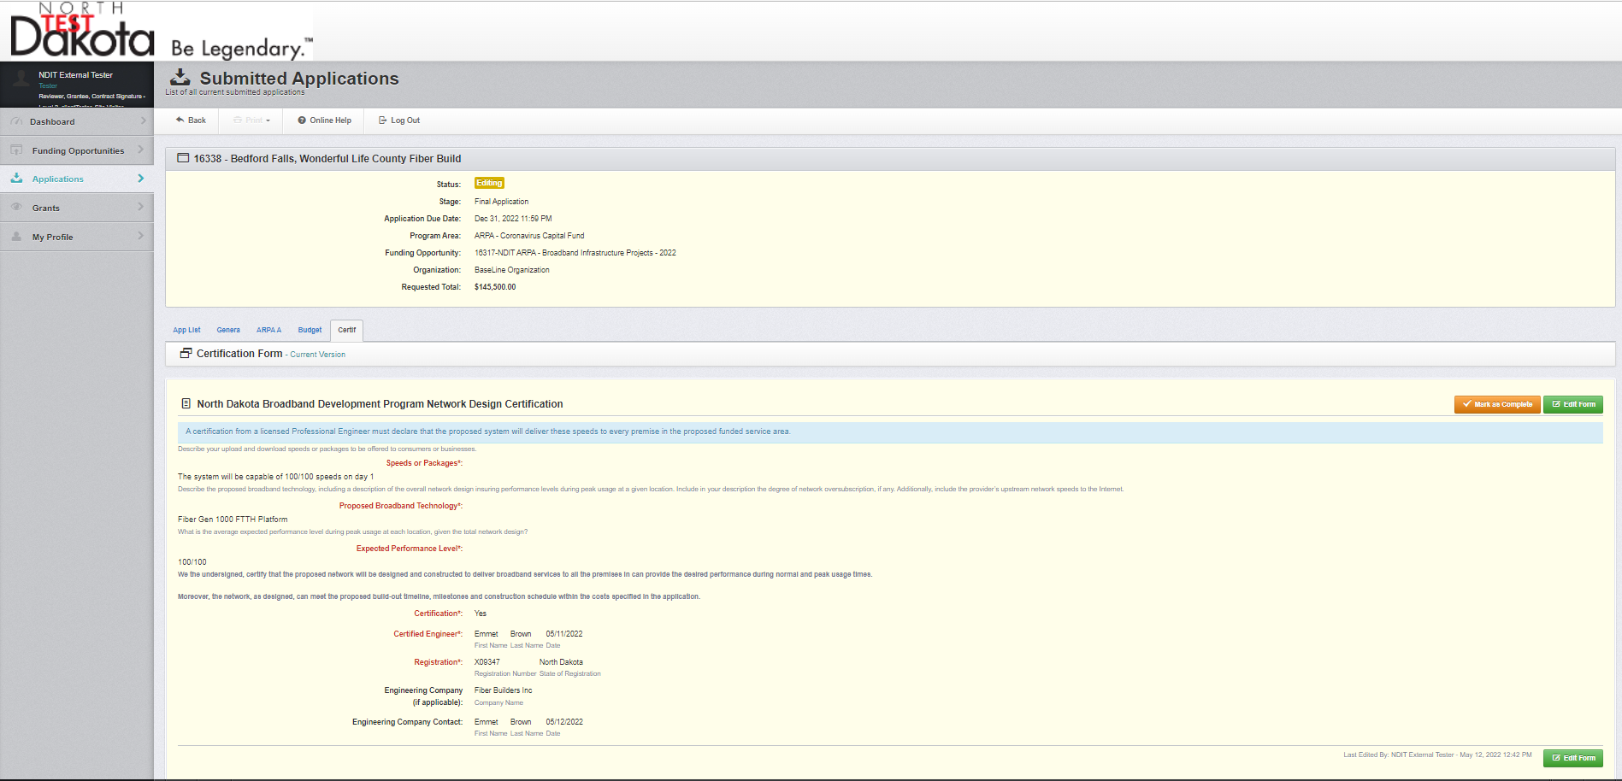
WebGrants Home Page
Network Design Certification - Complete

Slide 24
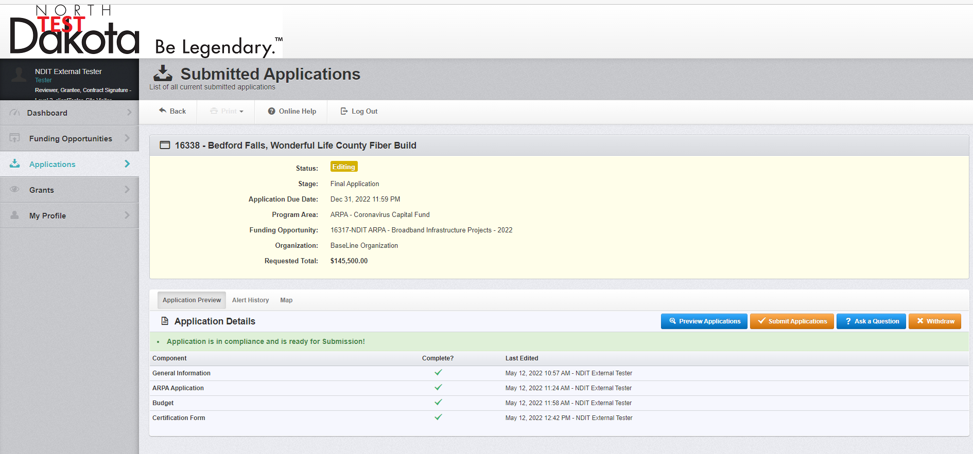
Application Home Page
Submit Application

Slide 25
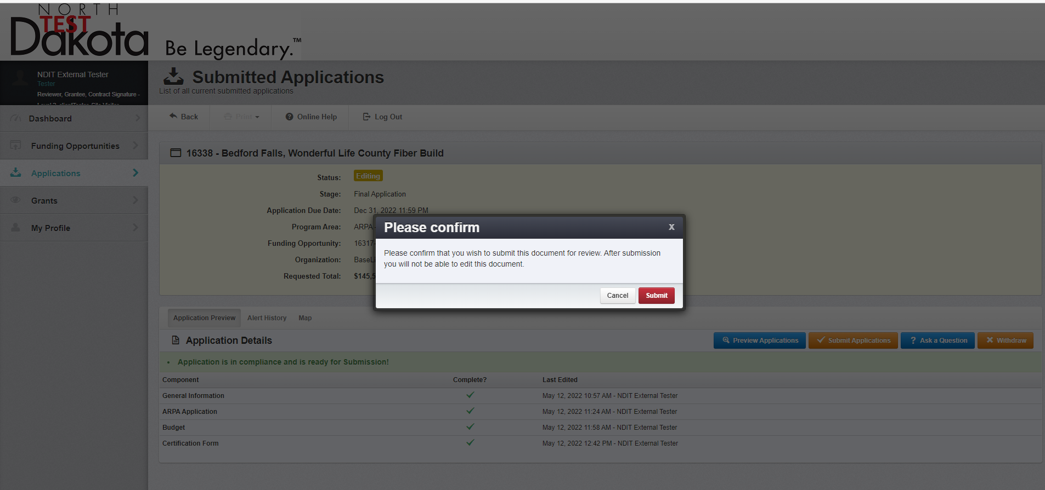
WebGrants Home Page
Application Home – Submit Application

Slide 26
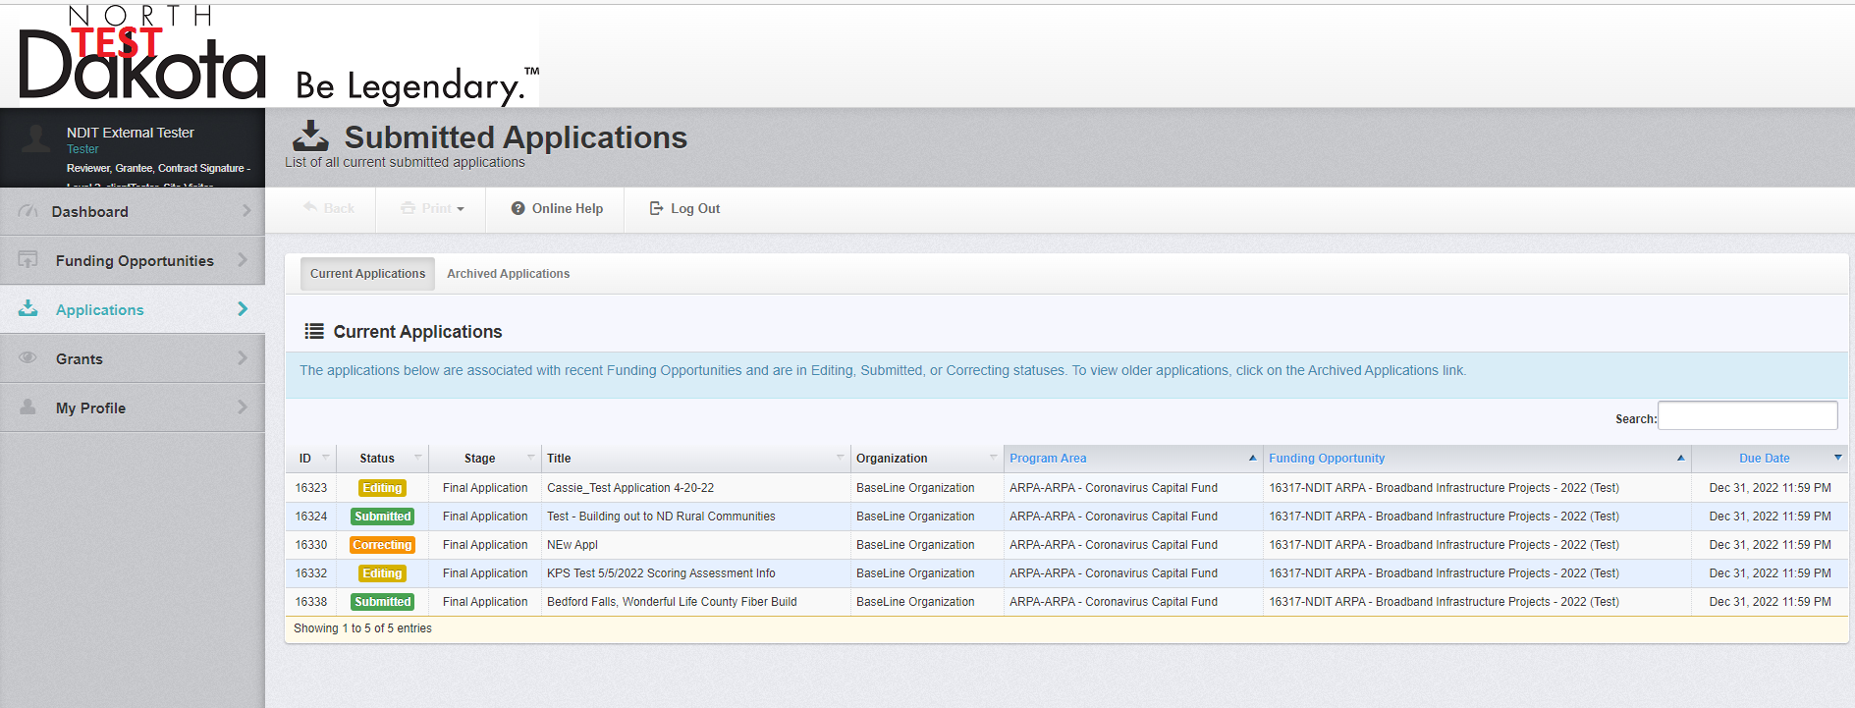
WebGrants Home Page
Application Home – Submit Application

Slide 27
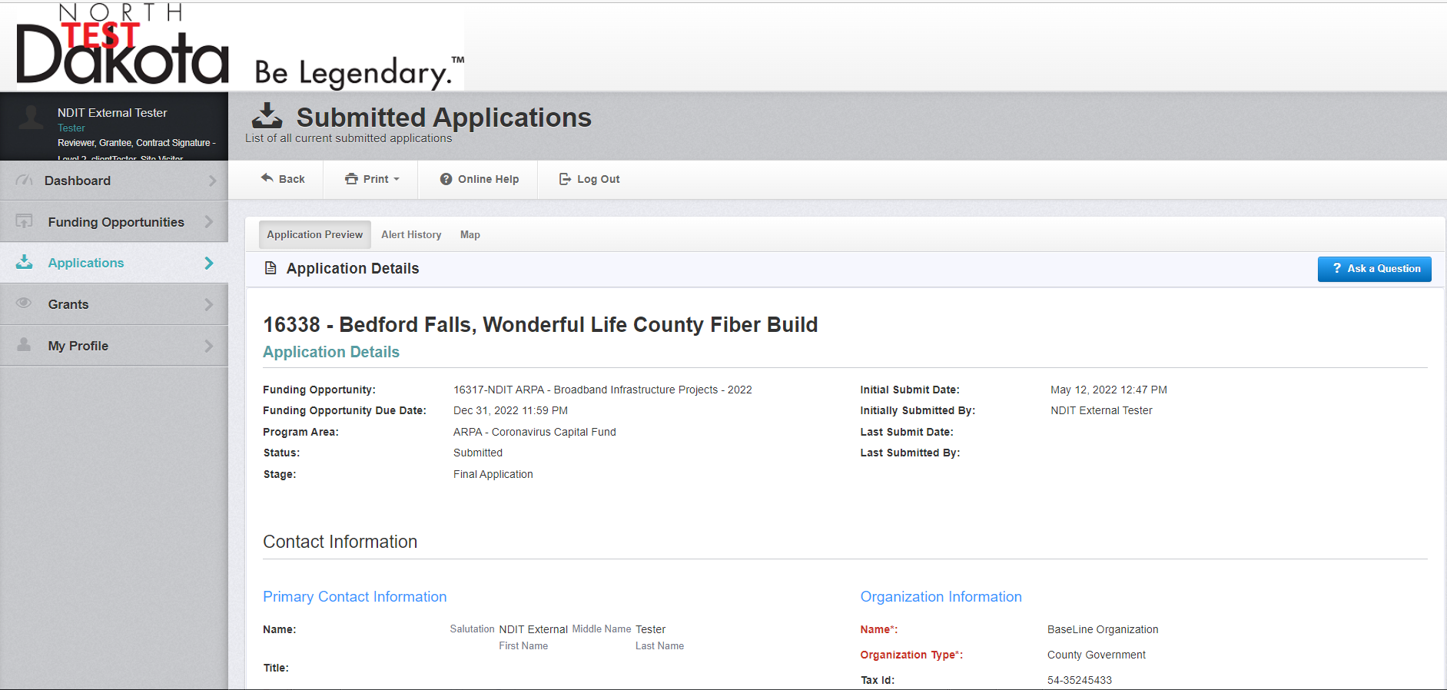
WebGrants Home Page
Application Home – Submit Application

