Slide 1

ND Broadband Grant Program Information and Proposed Structure
ARPA – Capital Projects Fund
Connecting North Dakota Communities
June 2022

Slide 2
Agenda
American Rescue Plan Act
Coronavirus Capital Projects Fund
State of the State
Where are the unserved/underserved
Grant Eligibility and Requirements
Application Process
Application Assessment
Grant Timeline and Key Dates

Slide 3
American Rescue Plan AcT
The American Rescue Plan Act of 2021, also called the COVID-19 Stimulus Package or American Rescue Plan, is a US$1.9 trillion economic stimulus bill passed by the US Congress on March 11, 2021, to speed up the country's recovery from the economic and health effects of the COVID-19 pandemic and the ongoing recession. Specifically, the Act allocated $10 billion for a Coronavirus Capital Projects Fund.
https://www.congress.gov/bill/117th-congress/house-bill/1319
(ARPA)

Slide 4
Capital Projects Fund
The Coronavirus Capital Projects Fund (Capital Projects Fund) will address many challenges laid bare by the pandemic, especially in rural America, Tribal communities, and low- and moderate-income communities, helping to ensure that all communities have access to the high-quality modern infrastructure, including broadband, needed to access critical services. The $10 billion in funds can be used for payments to eligible governments to carry out critical capital projects that directly enable work, education, and health monitoring, including remote options, in response to the public health emergency.
US Treasury Capital Projects Fund

Slide 5
Capital Projects Fund (CPF)
CPF to allow recipients to invest in capital assets that meet communities’ critical needs
  Broadband Infrastructure Projects
    Construction and deployment of broadband infrastructure designed to deliver service that reliably meets or exceeds symmetrical speeds of 100Mbps so that communities have future-proof infrastructure to serve their long-term needs.
  Digital Connectivity Technology Projects
    Purchase and installation of devices and equipment, such as laptops, tablets, desktop personal computers, and public Wi-Fi equipment, to facilitate broadband internet access for communities where affordability is a barrier to broadband adoption.
  Multi-Purpose Community Facility Projects
    Construction or improvement of buildings designed to jointly and directly enable work, education, and health monitoring located in communities with critical need for the project.
√
Areas of Investment

Slide 6
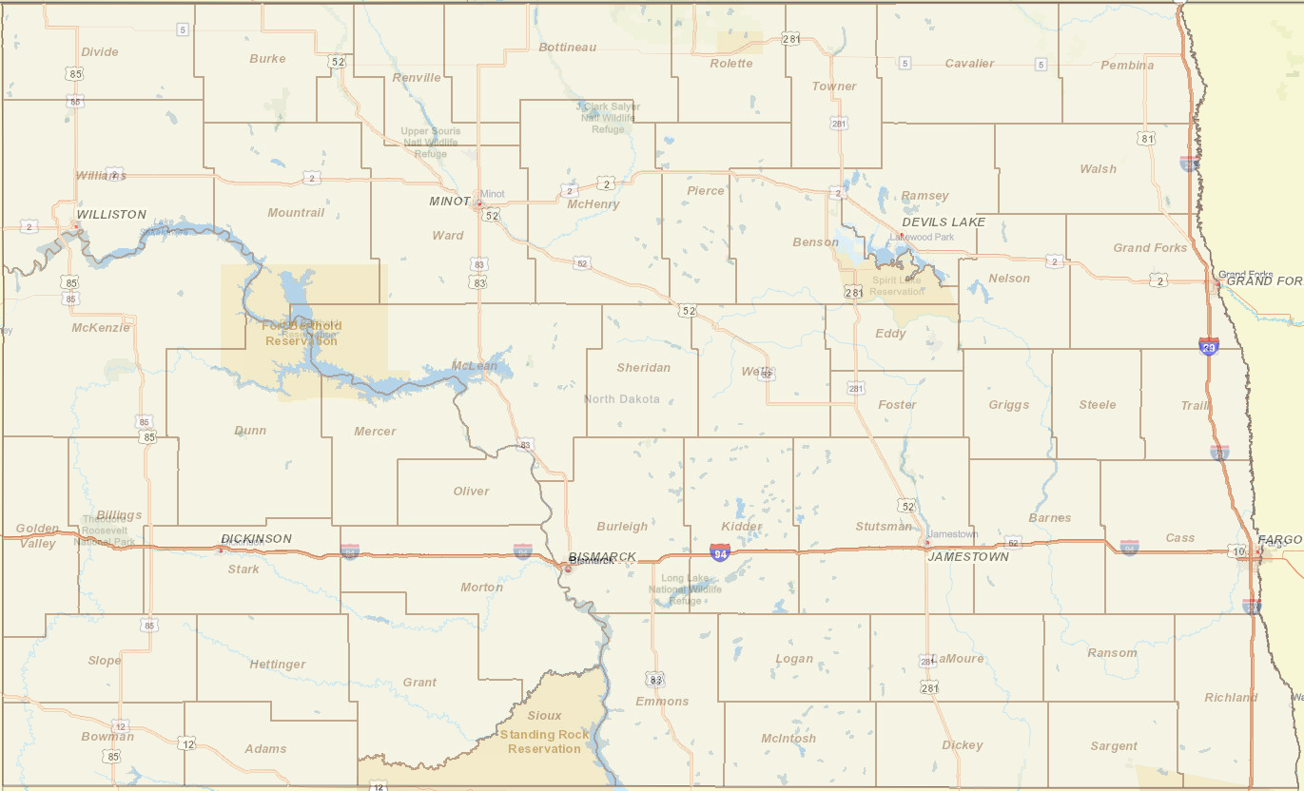
State of the State
19th largest state in terms of land area
  70,000+ square miles
3rd smallest in terms of population
< 800,000 residents
Rankings:
  Top 10 for internet access by US News and World Report
  #4 ranking for overall infrastructure
  Leads the nation for quality of life
75+% citizens have access to Gigabit services
  325+ communities
STAGEnet: All public section anchor tenant locations have a minimum of 1G and can acquire 100G if required. (All County Court Houses, School Districts, Higher Education Campuses, State Government Buildings)
  1st state to achieve 1Gb/s service delivered to every K-12 district
Less than 10,000 serviceable addresses that cannot acquire 1G service
95.4% of North Dakotans have access to 100Mb or greater

Slide 7
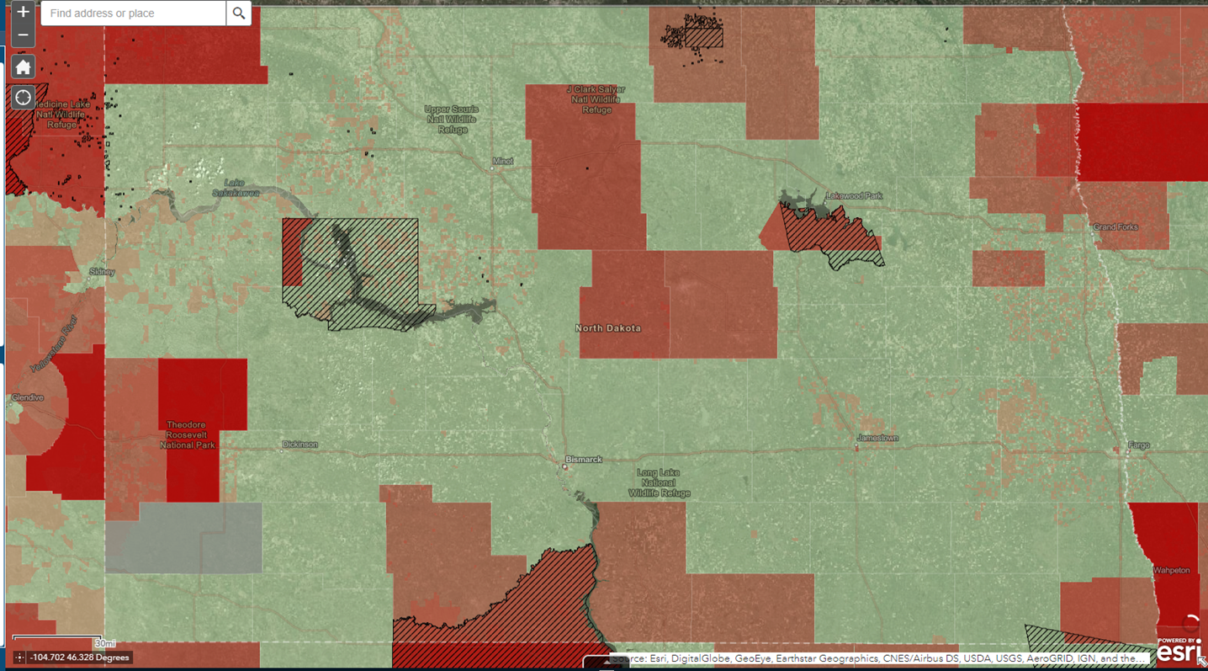
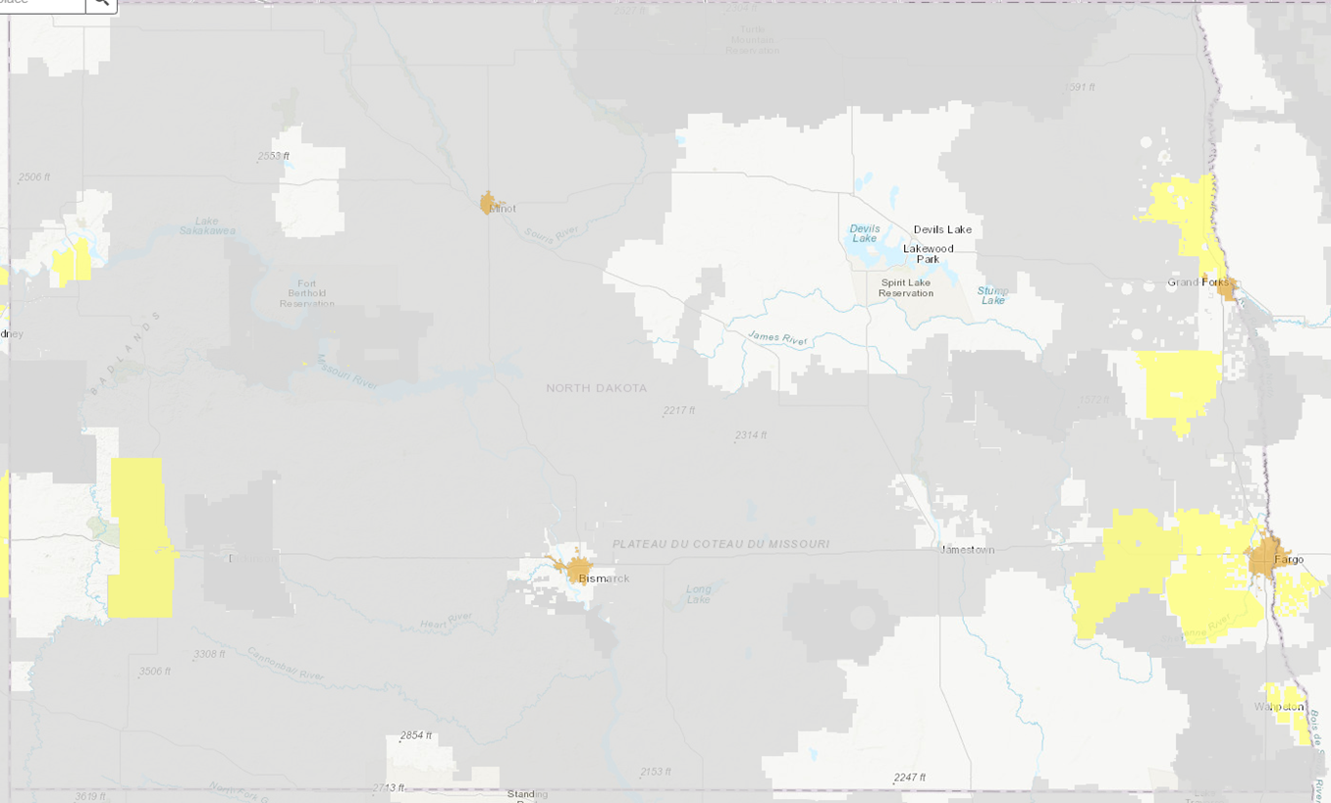
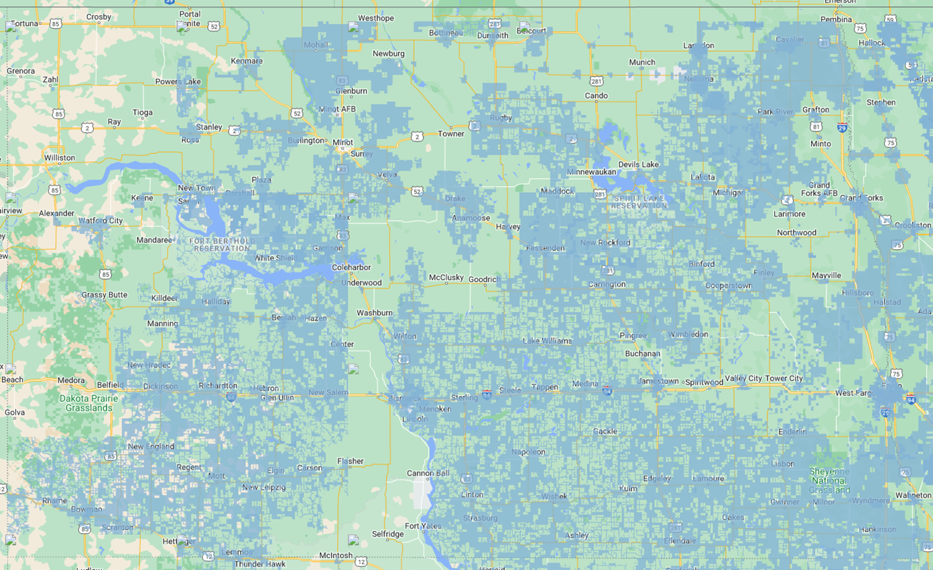
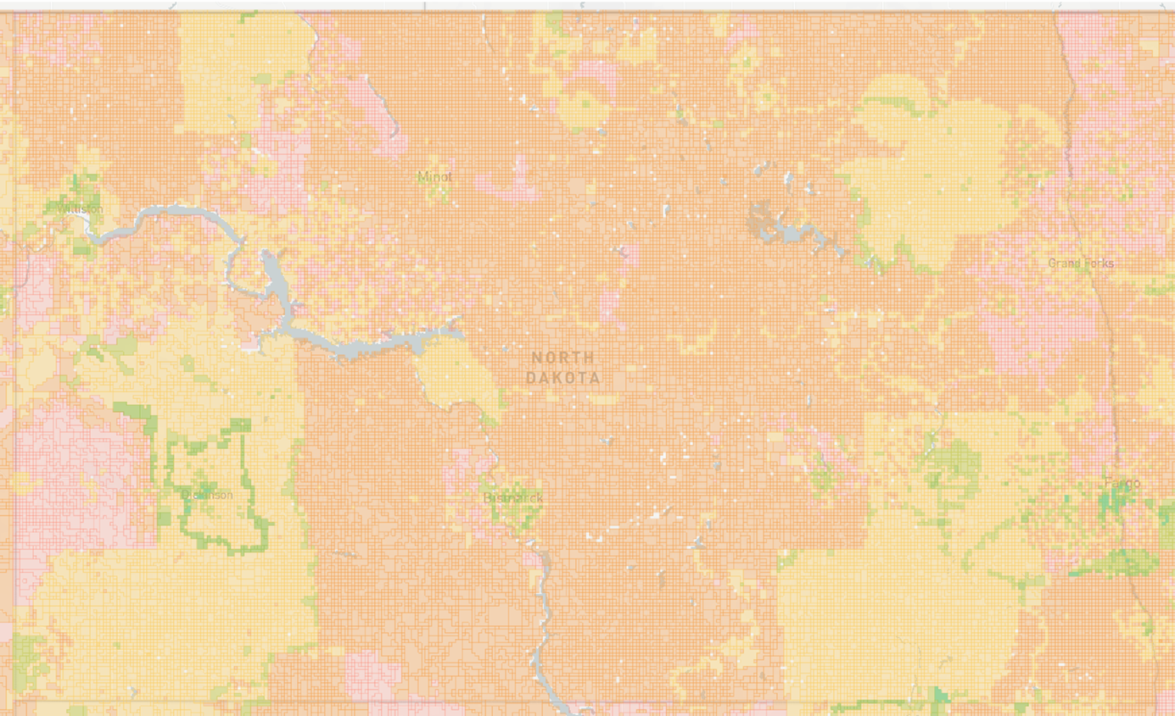
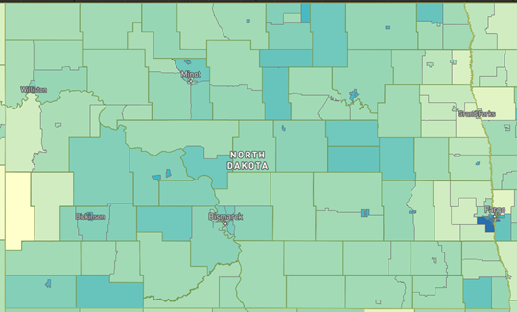
FCC Broadband Data Collection
Addresses the need for accurate data detailing where broadband service is and is not available
Service providers and governments use broadband maps to make decisions about where service is needed and how to fund the expansion of broadband services
The FCC is updating its current broadband maps with more detailed and precise information on the availability of fixed and mobile broadband services
Who must file?
Facilities-based providers of fixed and mobile broadband internet access who have one or more end user connections in service on June 30, 2022 must file.
When do you need to file?
The Commission’s Broadband Data Collection system will open on June 30, 2022
Data depicting broadband service availability as of June 30, 2022 are due no later than September 1, 2022.
For more information click: FCC Broadband Data Collection
Need good source for
identifying unserved
and under served
addresses?
BDC Program

Slide 8
Capital Projects Fund
Eligibility Requirements
The project invests in capital assets designed to directly enable work, education, and health monitoring
Utilize future proof technology
Networks should support 100/100 service day 1
  Exceptions will be considered
Service provider shall provide a % of the capital cost
  Not funded from another state or fed program
Funding will be limited to authorized CAPEX
  Not available for OPEX or other ineligible costs
Must address unserved or underserved addresses
Company financial viability is required
Applicants must participate in the FCC’s ACP
Grantees must participate in a qualifying affordability plans and in federal programs that provide low-income consumers with subsidies on broadband internet access services.
For more information check out these links:
ARPA Section 9901
US Treasury CPF Guidance and Eligibility Requirements
US Treasury CPF FAQ
Grant Recipient Reporting Requirements
Note: Service Providers will be required to complete quarterly and annual reports based on the US Treasury reporting guidelines. Application to the CPF Grant implies acceptance of this criteria.
Eligibility

Slide 9
Capital Projects Fund
Prioritization
Unserved before underserved
Projects that focus on the last mile activities
Fiber solutions
Affordability and cost efficiency
Addresses critical infrastructure needs / community facilities
Serves tribal land
Broadband speeds delivered
Project completion date
Evaluation
Speed Delivered and Technology
Financial Wherewithal
Addresses Served
Project Timeline
Services Offered
Operational Capability
Note: The goal of the NDIT Grant Program is to award grants for projects that exclusively extend broadband service into unserved and underserved areas. Applications are to be received through a competitive grant process that results in awards based on objective and efficient scoring methodologies. Each application received will be validated for its competitiveness, completeness, and eligibility.
Prioritization and Evaluation

Slide 10
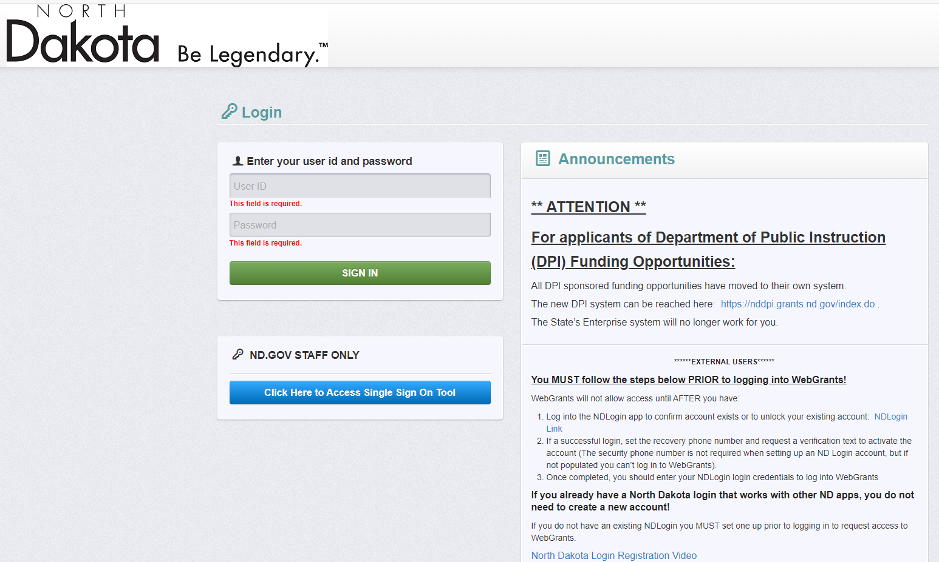
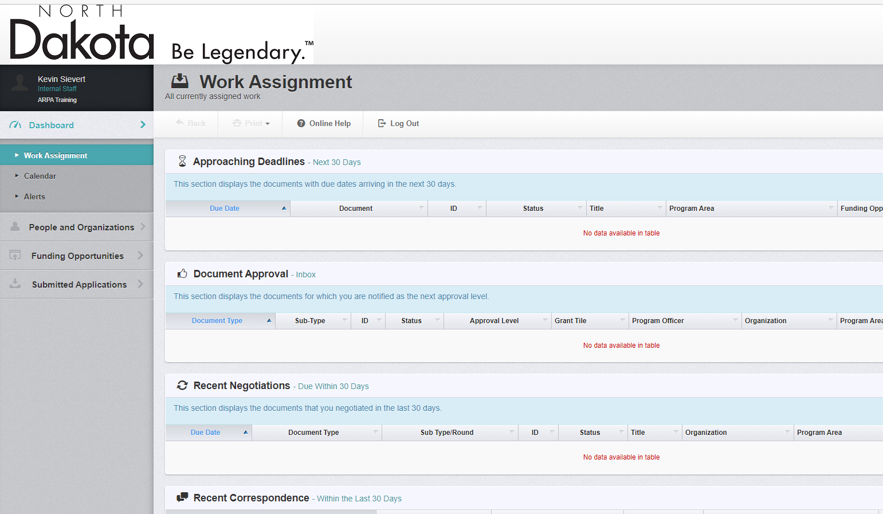
Application Process
Application Process
NDIT will be using a software package to manage the grant process from application to program closure.
SW is integrated with PeopleSoft and will be used to manage financials, payments, and reporting.
Grants will be paid out as follows:
  The first 20% of the project costs can be identified and requested upon grant award and signed contract with expectation that work begins immediately. A detailed project plan will be required for the payment of the 20%.
  Grantee will file reimbursement requests monthly as capital expenses are incurred and will be “paid” from the 20% upfront amount first
  Grantee will file reimbursements monthly and will be paid a maximum of an additional 70% of the grant total based on expenses and milestone completion.
  The remaining 10% of the grant total will be paid to the grantee when the project is completed (RFS) if those funds have been requested for reimbursement
Reimbursements can be requested on CAPEX items beginning 04/01/2022
WebGrants
WebGrants

Slide 11
Application Assessment
Speed Delivered
  The goal is to award grants for projects that exclusively extend broadband service into unserved and underserved areas. Each application received will be assessed and scored based on delivered speeds.
Financials and Operator Match
  Applicants are encouraged to provide as much of a match as possible. Scoring will be based on the percentage of the match.
  Applicants will also be scored on there financial stability and their ability to operate the network long term. All applicants must attach a summary of audited financials to demonstrate ability to fund at the above levels.
  Applicants with lower match requests should provide as much data explaining any extenuating circumstances for that consideration.
Farms/Business/Home Employment Served
  Applicants will receive points for the number and “quality” of unserved and underserved addresses and are encouraged to pre-subscribe customers.
Operational Capability
  SPs operational capability will be a factor included in the assessment
Critical Community Facilities
  Applicants will be awarded points for delivering services to critical community facilities (defined as law enforcement, fire stations, emergency operations centers, healthcare, education, military, state, or local government), Applicants must have the decision maker of the Critical Community Facility sign the pre-subscription form and submit the pre-subscription forms as part of the application.
Tribal Lands
  For applications where tribal lands are included, points will be awarded based on the percentage of addresses that fall within the tribal boundaries for the project.
Project Timelines
  Scoring will be based on: level of detail of engineering and design plan, financing secured, other approvals secured or in process (e.g. environmental, historic or architectural, etc.), project schedule thorough and complete, evidence of readiness to build, manage, and operate the project. Mandatory completion date for all projects is December 31, 2024.
Phone service offered
  Points will be awarded based on the applicant’s indicated participation in voice services and/or their implementation of a subscription plan for low-income or vulnerable populations.
Scoring

Slide 12
Key Timeline / Milestones
Sept 16, 2022 Proposed grant program will be announced
Sept 30, 2022 Community feedback and comments due
Oct 14, 2022 Grant application period will begin
Dec 2, 2022 Round 1 - Applications due 4:00 pm CT
Dec 23, 2022 Proposed Round 1 awards will be made available for public comment
Jan 13, 2022 Public comments / challenges due
Jan 27, 2022 Awards for projects will be announced
Sept 30, 2024 All 2022 project applicants must have construction completed and provide service to customers
Proposals that cannot meet this timeline must be submitted with justification to support the timeline.
Dec 31, 2024 Mandatory completion date for this category of projects
The State may offer additional application periods in the future.
All dates are estimates and may be adjusted based on circumstances surrounding response from U.S Government as well as feedback from the community
Proposed – Dependent on Grant $ from FED

Slide 13
Feedback
1) Feedback provided on cost of engineer certification of the application.
  Change: The application will require Executive Certification (Company VP or higher) to certify the expected performance and the Engineering Certification will move to the contract which will be post award decision.
Feedback provided on 2 year program buildout extensions.
  Change/Clarification: The State wants to expedite the network buildout of the unserved and underserved addresses and has defined a goal of 2 years for this construction. We understand that there may be some issues meeting this schedule (supply chain) and will consider projects with proposed completion dates beyond 12/31/24; however, Project Completion Date is one of the scoring metrics that will be used in ranking of the projects.
Feedback on Award Challenge Process – Challenge Rebuttal
  Clarification: In the event of a grant award challenge, the applicant will have an opportunity to address the challenge with a formal rebuttal. The State will consider the challenge and rebuttal and will make a decision. If more information is required, the state will coordinate/communicate with the applicant and challenger.
  Feedback on Timeframe of the Program
    The State has allocated 1 additional week to the application period and 1 additional week to the challenge period.
Summary of Program Changes

